Slide 1
COLLEGE OF ENGINEERING TRIVANDRUM, KERALA, INDIA
STUDENT CHAPTER CET
2021 -2022
1

Slide 2
Contact Information
College of Engineering Trivandrum
Engineering College, Sreekaryam - Kulathoor Rd, P.O, Sreekariyam, Thiruvananthapuram, Kerala, India 695016
ascecet@cet.ac.in
asce_cet
ASCE Student Chapter CET

Slide 3
STUDENT OFFICERS
President Arya Arun Nair
arya1972305@gmail.com
+91 7025666352
Vice president Sreenaja V.P.
sreenaja97@gmail.com
+91 9497724642
Recording Secretary Delvin J. Joseph delvinjeroldjoseph@gmail.com +91 9495981243
Corresponding Secretary Kavitha Suresh
kavithassh1729@gmail.com
+91 7012425155
Treasurer Mohammed Ashmil ashmilmuhammed619@gmail.com
+91 9072991196
Program Coordinator Jacqueline Jain
jacquelinej1512@gmail.com
+91 9400747115
ASCE Student Chapter CET

Slide 4
ADVISORS
Faculty Advisor Dr. Anusha S.P.
anushanair@gmail.com
+91 9446779699
Practitioner advisor Mr. Abhijith S.
abhijith9142@gmail.com
+91-9142315895
Practitioner advisor Dr. Unnikrishnan S. Pillai supillai1@yahoo.com +919446559362
ASCE Student Chapter CET

Slide 5
FINANCIAL SUMMARY
Dues structure ($ 37.5/year)
As of January 31, 2022
Total income: NIL
Total expenditures: NIL
Cash balance: NIL
Accounts receivable: NIL
Accounts payable: NIL
ASCE Student Chapter CET

Slide 6
GOALS AND OBJECTIVES
VISION
Develop students with technical and leadership skills that would enable them to transform into full-fledged civil engineers to serve the society
MISSION
To impart students with the technical know how on the fields of emerging technologies and new developments in professional practices
To imbibe ethical, social and environmental perspectives in their field of work
To develop creativity, leadership skills and interpersonal skills
ASCE Student Chapter CET

Slide 7
GOALS AND OBJECTIVES
GOAL 1: Encourage all students to join the ASCE Student Chapter and thereby create opportunities for them to connect with the civil engineering fraternity around the world
•Encourage students to participate in forums and organise events where they can interact with civil engineering professionals and researchers around the world
GOAL 2: Impart the members with the skill and knowledge needed to contribute to academic and industrial research in engineering and allied disciplines
•Identify strengths and weaknesses of the students and give them opportunities to build on their strengths and overcome weaknesses so as to preform well in their career
GOAL 3: Provide appropriate, sustainable and affordable solutions with society concerns
•Organize activities where students will understand the ground realities and focus their efforts in serving the society
ASCE Student Chapter CET

Slide 8
GOALS AND OBJECTIVES
GOALS ACTION TARGET RESULTS
PLAN
Goal 1
Increase
membership
Increase membership by
50%
Increased membership by
65%
Goal 2
Skill development programs
Knowledge sharing platforms
Invited lectures (5)
NB: No industrial visits due to COVID restrictions
1 community service
3 student competitions
Invited lectures (3)
Industrial visits (2)
Community service (1)
Student competitions (2)
Goal 3
Blood donation camp
Poster making competition
Pitchathon, International disability day
Blood donation camp
Poster making competition
Community service
Sustainable solutions
ASCE Student Chapter CET

Slide 9
Membership Statistics
Total number of Student Group members: 358
Total number of ASCE National Society-level members: 1
ASCE Student Chapter CET

Slide 10
Meeting Statistics
Number of professional meetings with an invited speaker:5
Number of meetings with student presentations and/or paper(s) presented:1
Number of field trips: nil (Due to COVID restrictions)
Number of social functions:3
Number of Officer/Planning Meetings:5
ASCE Student Chapter CET

Slide 11
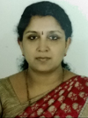
ASCE STUDENT CHAPTER INITIATION INAUGURATION
Dr. Mini Soman
Head of the Department, Department of Civil Engineering, College of Engineering Trivandrum
Concrete structures, Special Concretes, Repair and Rehabilitation, Sustainable Construction
Prospects of student chapter in moulding professionals
Inaugural Speech
May 28,
4:00 p.m. to 5:00 p.m.
Maximum participants attended – 70
viv-apwz-bqo
Dr.Elias Boutros Sayah
Director, ASCE Region 10
Felicitation
ASCE Student Chapter CET

Slide 12
PROFESSIONAL MEETINGS WITH AN INVITED SPEAKER
1. Why speed is fundamental to road safety and the consequence for its management - 12-02-2021, Dr. John Fletcher, Principal Road Safety Specialist, TRL, UK [Webinar]
2. Some thoughts on the principles of bituminous pavement design - 05-03-2021, Dr. Animesh Das, Professor, Department of Civil Engineering, IIT Kanpur [Webinar]
3. Estimating and Forecasting Transportation Metrics: Lessons Learned - 2-03-2021, Prof. Laurence R. Rilett, Keith W. Klaasmeyer Chair in Engineering and Technology [Webinar]
4. Overview and Importance of Road Safety - 19-03-2021 , Dr. Udit Jain, Assistant Professor, VNIT Nagpur 2021 [Webinar]
5. How to explore Job & Migration Opportunities in Tough market - 24-07-2021
Ajish R & Dipindas, M-Tech (NITK) Gold Medalist, Mentor, FACELIFT [Interaction with professionals]
ASCE Student Chapter CET

Slide 13
PROFESSIONAL MEETINGS WITH AN INVITED SPEAKER
6. Innovative Construction Solutions with Geosynthetics - 15-08-2021, Jayakrishnan P V, Regional Technical Manager, Maccaferri, Middle East, Dubai, UAE[Webinar]
7. Building Information Modelling - 30-10-2021, Madav Sreekumar & Lakshmi N. Suresh, Technical Consultant, Marketing & Strategy Manager [Interaction with professionals]
8. Career Guidance - 06-12-2021, Mr. Anandu B.and Mr. Rahul Krishnan, Futton academy [Interaction with professionals]
9. First and second year orientation – 16-12-2021, Dr. Kishor P., Director, Habilete Learning Solutions Private Limited. [Interaction with professionals]
ASCE Student Chapter CET

Slide 14
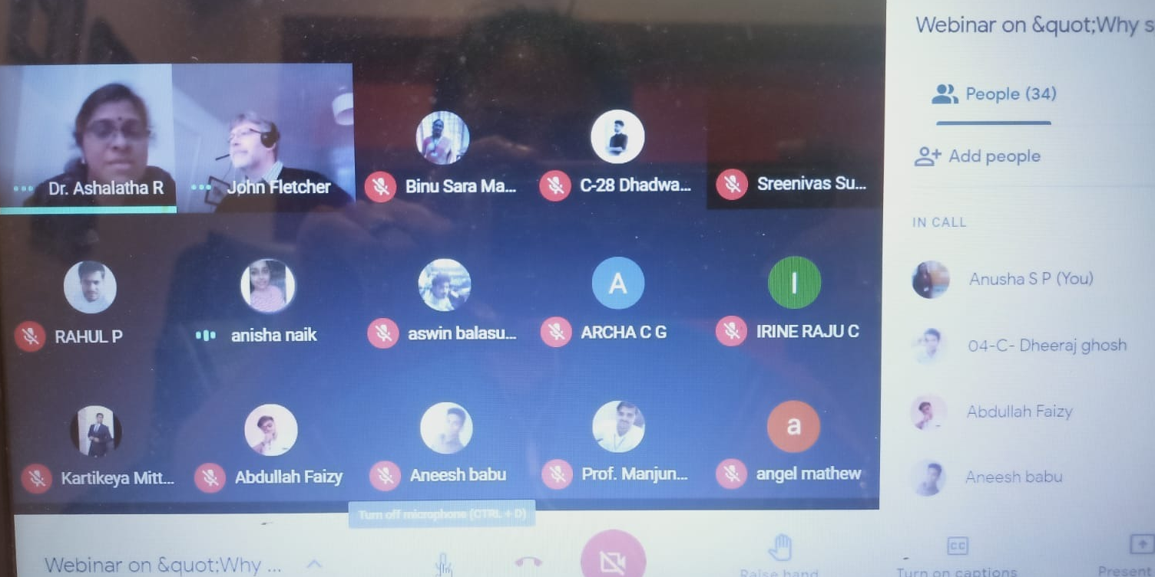
Why speed is fundamental to road safety and the consequence for its management
Dr. John Fletcher,
Principal Road Safety Specialist, TRL, UK
February 12,
4:00 p.m. to 5:00 p.m.
Maximum participants attended - 70
nay-hiyq-prq
Road safety issues, recommendations for policy decisions
ASCE Student Chapter CET

Slide 15
Some thoughts on the principles of bituminous pavement design
Dr. Animesh Das
Professor
Department of Civil Engineering
IIT Kanpur.
March 5,
4:00 p.m. to 5:00 p.m.
Maximum participants attended - 75
Meeting ID: 945 7525 2281 Passcode: 614580
Pavement design principles
Overview and Importance of Road Safety
Dr. Udit Jain
Assistant Professor
Department of Civil Engineering
VNIT Nagpur
March 19,
4:30 p.m. to 5:30 p.m.
Maximum participants attended - 50
whq-nzpg-cyg
Road safety – concerns and solutions
ASCE Student Chapter CET

Slide 16
Travel Time Reliability (TTR) Estimation and Forecasting
Laurence R. Rilett, Ph.D., P.E. , F.ASCE
Keith W. Klaasmeyer Chair in Engineering and Technology, Director, Nebraska Transportation Center, Director, Mid-America Transportation Center
March 12,
8:00 p.m. to 9:00 p.m.
Maximum participants attended - 80
wxr-xxsc-tpj
Issues in using simulation models for estimation
ASCE Student Chapter CET

Slide 17
How to explore Job & Migration Opportunities in Tough market
Ajish R & Dipindas,
M-Tech (NITK) Gold Medalist, Mentor, FACELIFT
July 24,
2:00 p.m. to 3:00 p.m.
Maximum participants attended - 40
rcq-omzo-won
Job and migration opportunities
Building Information Modeling
Madav Sreekumar & Lakshmi N. Suresh,
Technical Consultant, Marketing & Strategy Manager
October 30,
3:30 p.m. to 4:30 p.m.
Maximum participants attended - 60
Meeting ID: 86517171801 Passcode: 539891
Catalysing the designer for making innovative building solutions
ASCE Student Chapter CET

Slide 18
Career Guidance
Mr. Anandu B.and Mr. Rahul Krishnan,
Futton academy
December 6,
7:00 p.m. to 8:00 p.m.
Maximum participants attended - 50
oip-nmec-zrj
Higher education opportunities
First and second year orientation
Dr. Kishor P.,
Director, Habilete Learning Solutions Private Limited.
December 16,
4:15 p.m. to 5:30 p.m.
Maximum participants attended - 50
In person
Demonstration of benefits of ASCE membership for students
ASCE Student Chapter CET

Slide 19
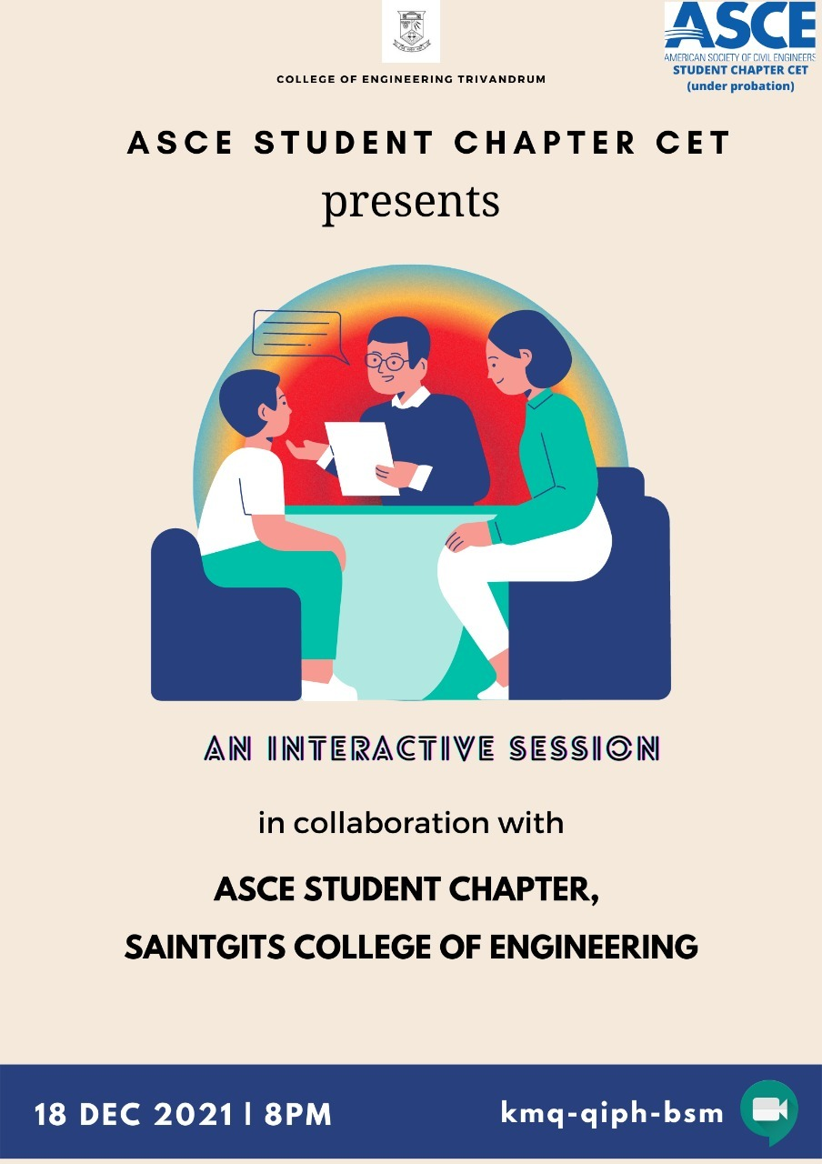
INTERACTION WITH ANOTHER STUDENT CHAPTER
Mr. Cherian C. K. and Mr. Jithin Kurian Andrews,
Saintgits College of Engineering, Kottayam
December 18,
8:00 p.m. to 9:00 p.m.
Maximum participants attended - 40
kmq-qiph-bsm
Achievements and experiences of the ASCE student chapter members
ASCE Student Chapter CET

Slide 20
STUDENT COMPETITIONS
Poster making competition - Based on World Environmental Day on June 5,
Open to all students
Judgement based on solutions for food, water, housing, transportation, waste disposal
Submissions in video format or as write up
Last date: June 3, 2021
ASCE Student Chapter CET

Slide 21
STUDENT COMPETITIONS
Quiz competition - Based on Engineers Day on September 15
Open to all students
September 15, 2021, 7:00 p.m.
1st prize: SHEETAL SAMBHU
ASCE Student Chapter CET

Slide 22
STUDENT COMPETITIONS
Based on International Day of Persons with Disabilities
Poster making competition open to students of CET
Judgement based on societal challenges and ideas to support them
Last date: December 2, 2021
1st prize: SWETHA C LOUIS
IInd year,
Department of civil Engineering,
CET
ASCE Student Chapter CET

Slide 23
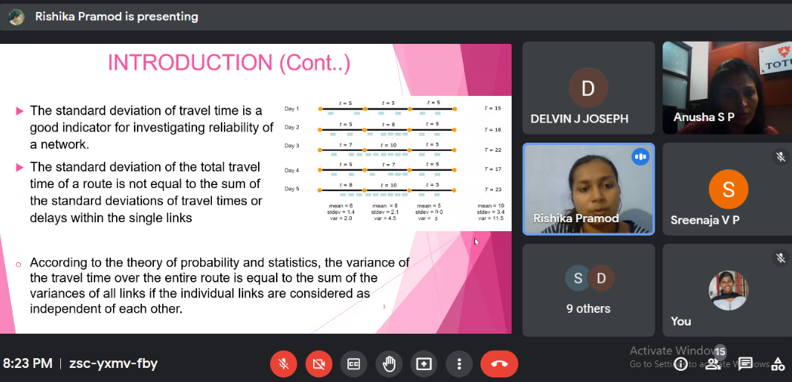
STUDENT PAPER PRESENTATION
Based on research work of post graduate students
Open to post graduate students of CET
Judgement based on innovation and novelty of work
1st prize: CHITHRA A. SAIKRISHNA
IInd year, Traffic and Transportation Engineering Division
Department of Civil Engineering,
CET
ASCE Student Chapter CET

Slide 24
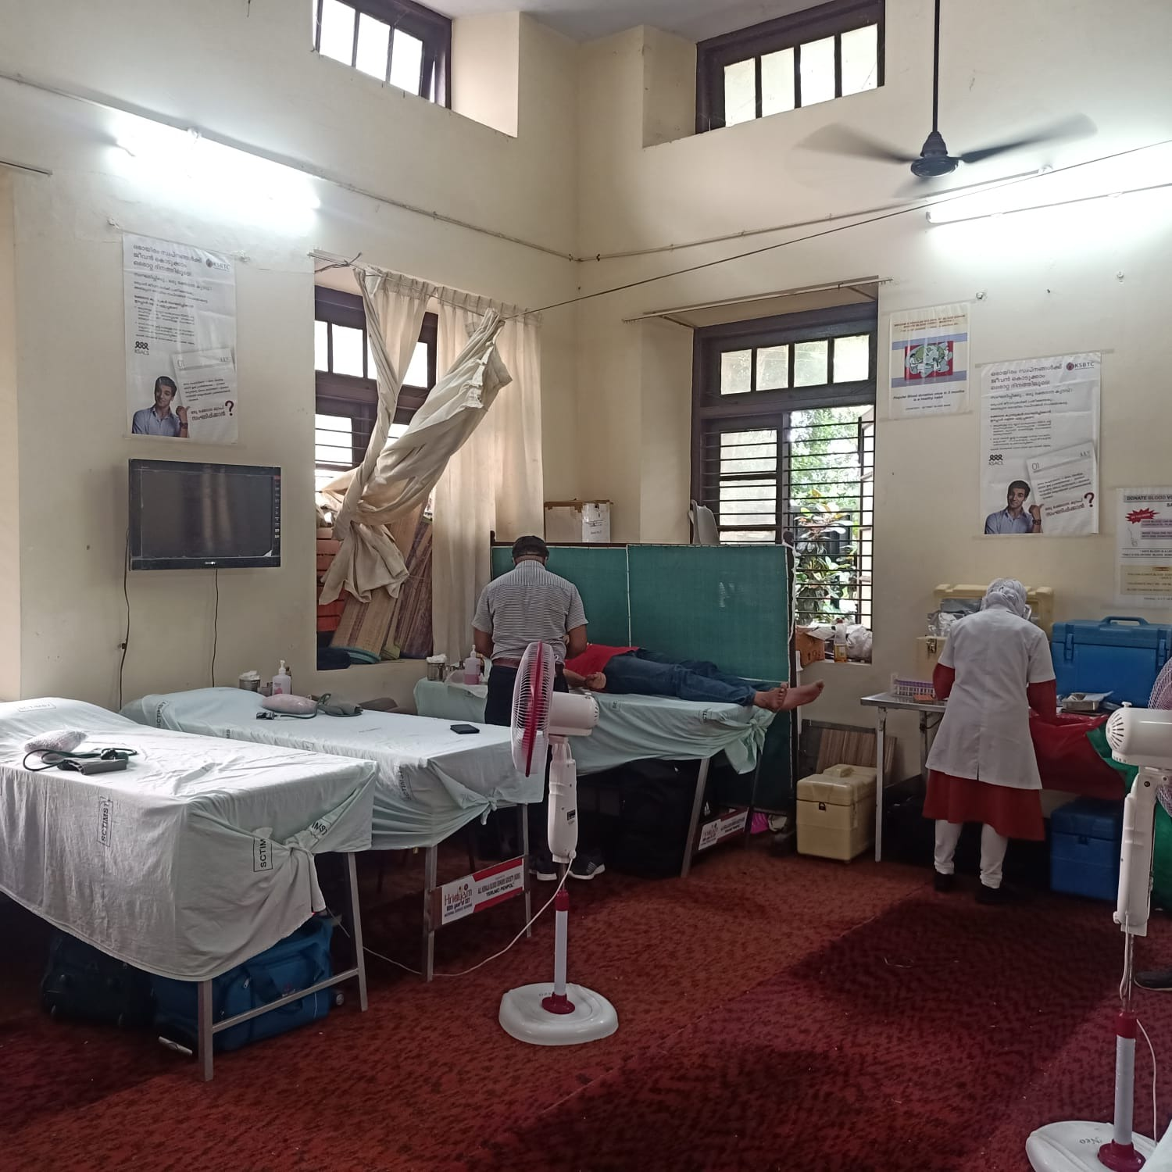
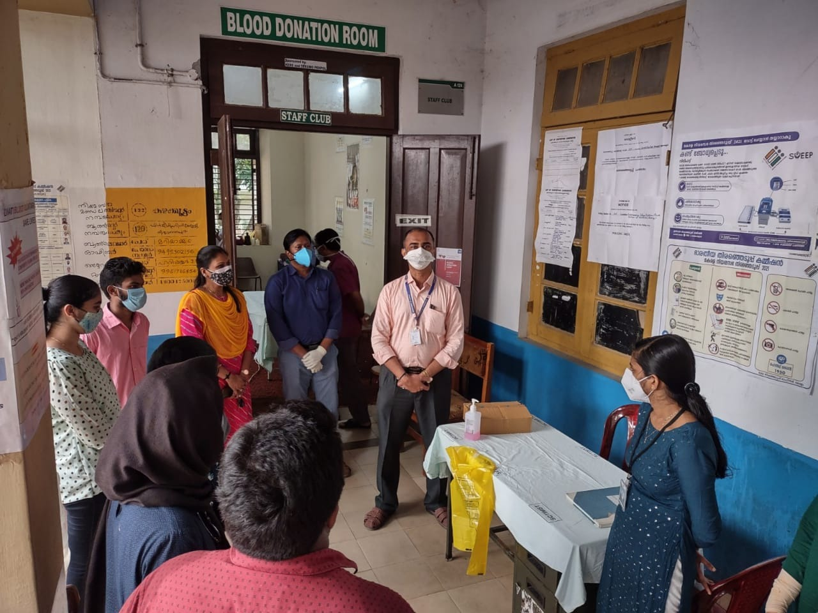
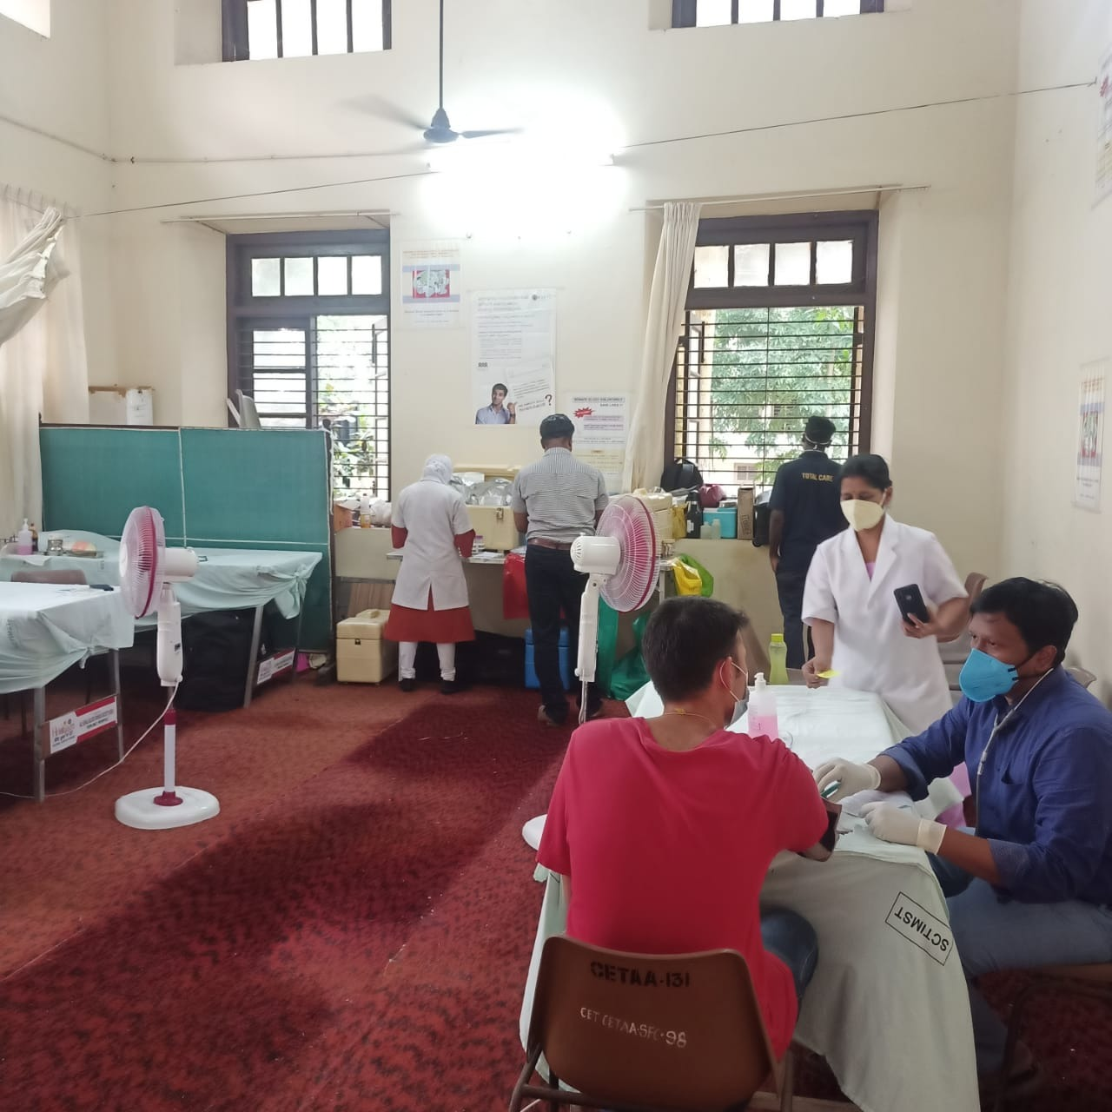
COMMUNITY SERVICE
39 blood donations
Imparted community service spirit to the volunteers
ASCE Student Chapter CET

Slide 25
SUMMARY AND QUESTIONS
What were the most significant events of the year?
The entire year was significant with series of events. The community service and the interactive sessions with experts and student competitions instilled a sense of responsibility and awareness to the student members
What were the most significant challenges?
Absence of students in the campus due to COVID
Future plans
Student conference
Community outreach programs
Skill development based on industrial requirements

