Slide 1
CONCRETE LAB (MATERIAL TESTING LAB II) EXPERIMENTAL PROCEDURES

Slide 2
1. Determination of specific gravity and soundness of cement
Procedure
1.Fill the dry flask with kerosene up to about 1 ml and note the initial reading.
2. Add around 60 g of cement carefully so the level rises to about 22 ml.
3. Roll the flask gently to remove air bubbles and record the final reading.

Slide 3
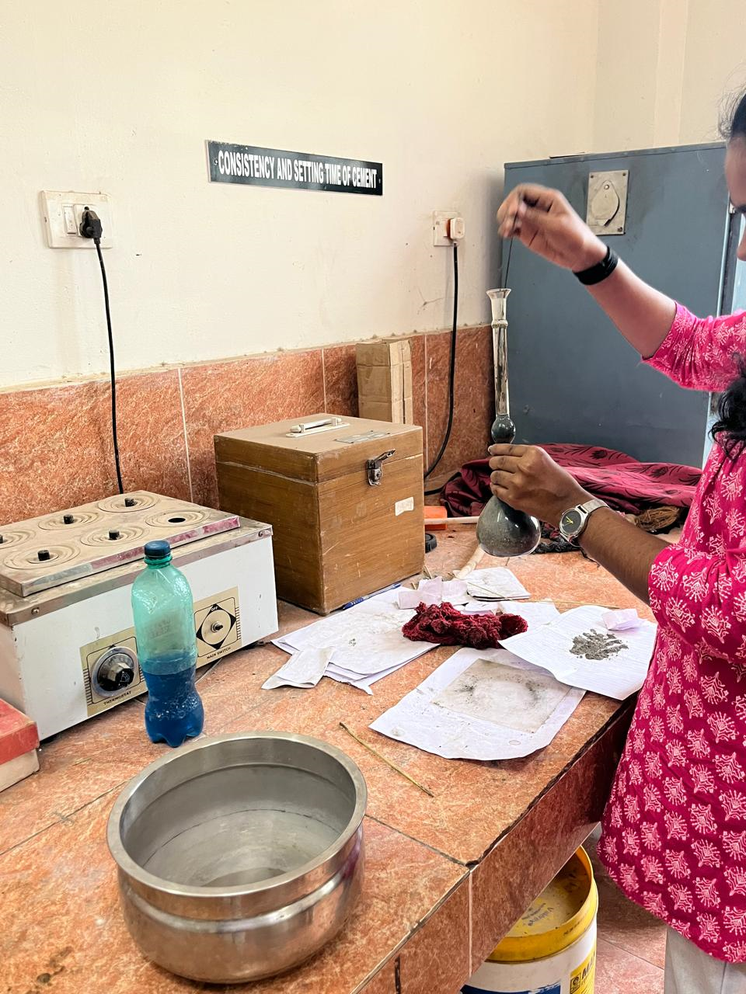
Fig.1 Specific gravity test

Slide 4
2.Determination of Standard Consistency, Initial and Final Setting Time, Compressive Strength of Cement
STANDARD CONSISTENCY
1.Mix 300 g of cement with about 30% water to make a paste and fill it into the Vicat mould within 3–5 minutes.
2.Place the mould under the Vicat plunger and note how deep it penetrates into the paste.
3.Adjust the water content and repeat the test until the plunger penetrates 5–7 mm from the bottom — this water percentage is the standard consistency of the cement.

Slide 5
INITIAL AND FINAL SETTING TIME
1. Mix 300 g of cement with 0.85 times the water needed for standard consistency and fill the Vicat mould within the gauging time.
2. Test penetration using the square needle — the time from adding water until the needle fails to pierce beyond 5 ± 0.5 mm indicates the initial setting time.
3. Replace the needle with the annular one, when only the needle makes an impression, that time marks the final setting time.

Slide 6
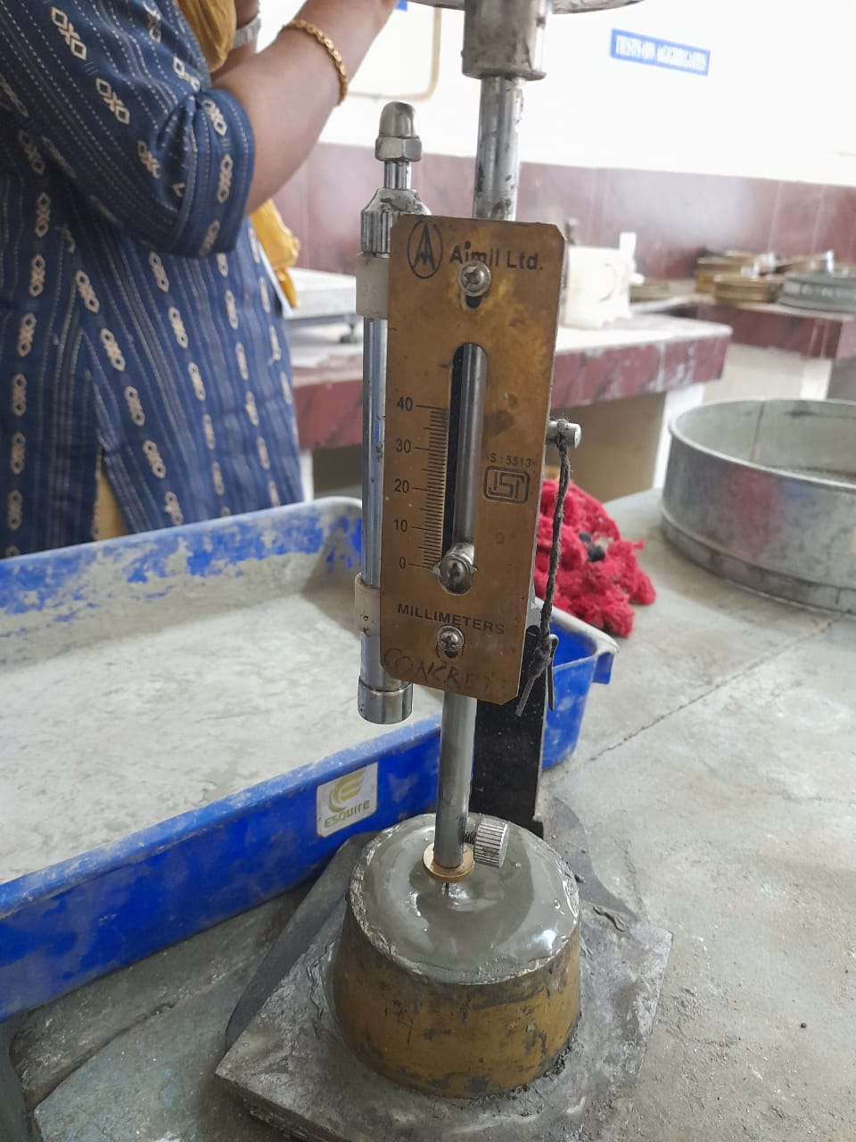
Fig.2 Initial setting time set up

Slide 7
COMPRESSIVE STRENGTH OF CEMENT
1. Mix cement and standard sand in a 1:3 ratio (200 g cement and 600 g standard sand) and add water equal to P/4 + 3% of their combined weight to make a uniform mortar.
2. Fill the cube moulds, compact properly, smooth the surface, and keep undisturbed for 24 hours, then remove and cure the cubes in water.
3. After 7 days and 28 days test at least three cubes in a compression testing machine, and take the average value as the compressive strength

Slide 8
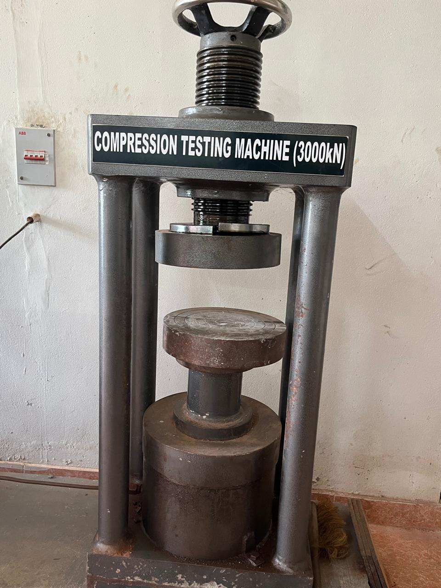
Fig . 3 Compression testing machine

Slide 9
3. Tests on fine aggregates
SPECIFIC GRAVITY AND BULK DENSITY
1. Fill the measure one-third with mixed aggregates, tamp 25 times, then repeat twice more until full and level off the surface.
2. Weigh the measure with aggregates (W1), then fill it with water to the top and weigh again (W2).
3.Empty, clean, and fill the measure with only water to find its weight (W3).

Slide 10
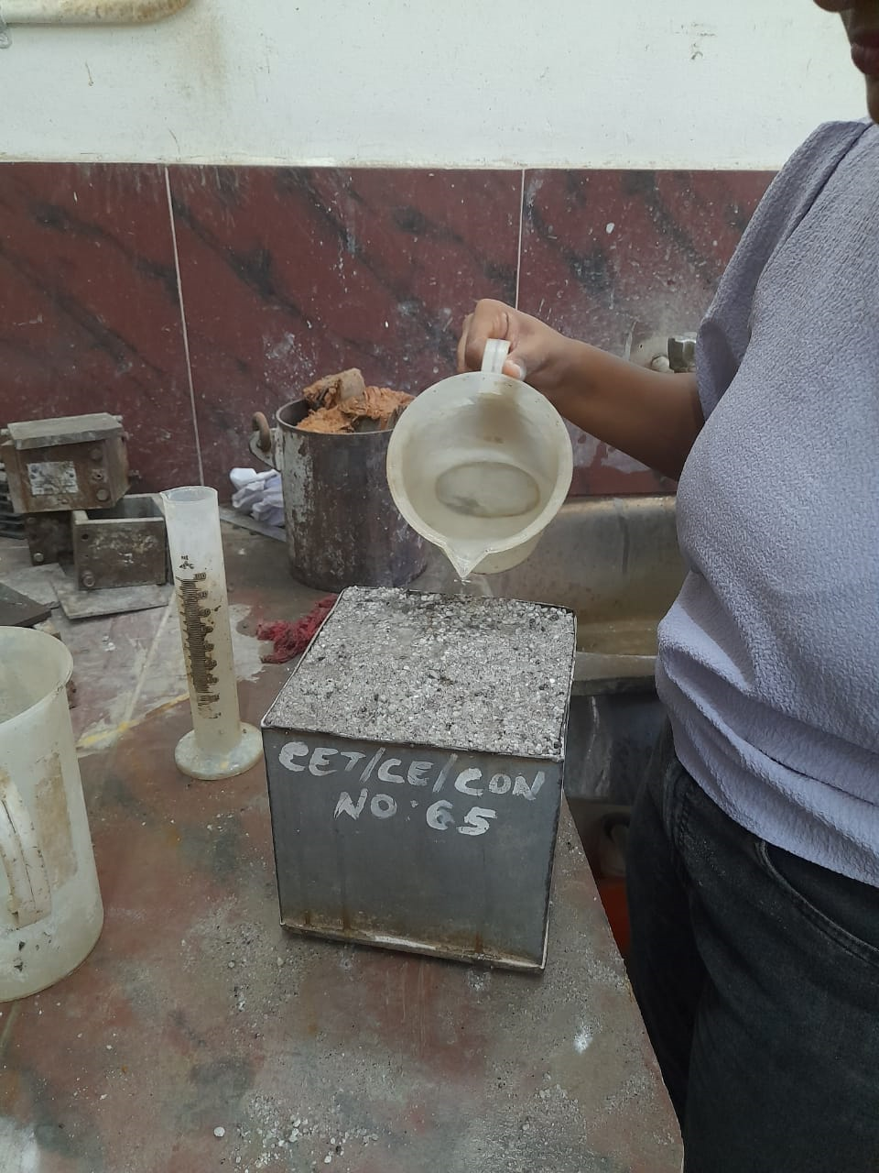
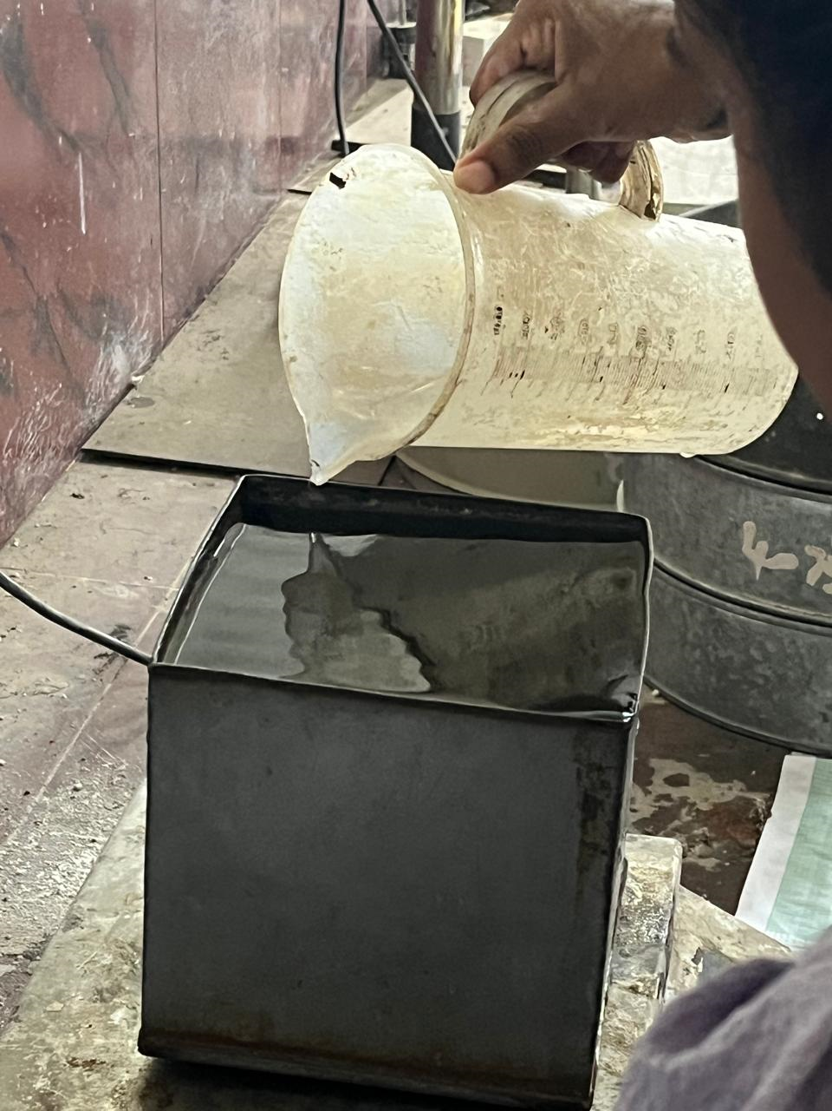
Fig.4 Testing of Bulk density of fine aggregate Fig.5 Filling measure with water

Slide 11
SIEVE ANALYSIS OF FINE AGGREGATE
1.Take about 3 kg of air-dried coarse aggregate and arrange sieves in the order: 80 mm, 40 mm, 20 mm, 10 mm, and 4.75 mm (largest on top).
2. Sieve the sample for at least 15 minutes using varied motions without forcing material through the sieve.
3.Weigh the amount of aggregate retained on each sieve to determine the particle size distribution.

Slide 12
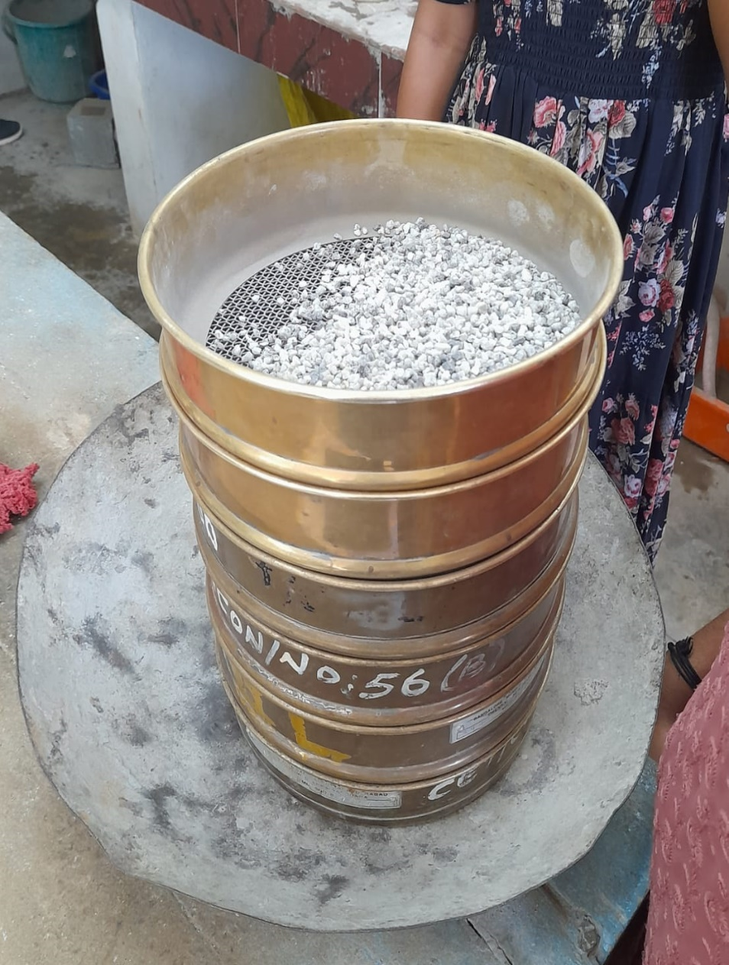
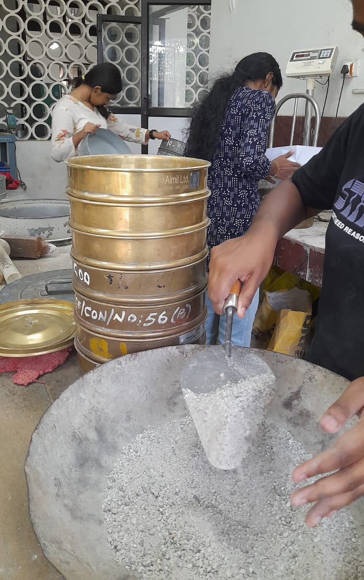
Fig.6 Sieve analysis of fine aggregate

Slide 13
4. Tests on coarse aggregates
SPECIFIC GRAVITY AND BULK DENSITY
1. Fill the measure one-third with aggregates, tamp 25 times, repeat twice more until full, and level off the top.
2. Weigh the measure with aggregates (W1), then fill it with water to the top and weigh again (W2).
3. Empty, clean, fill the measure with only water, and record its weight (W3).

Slide 14
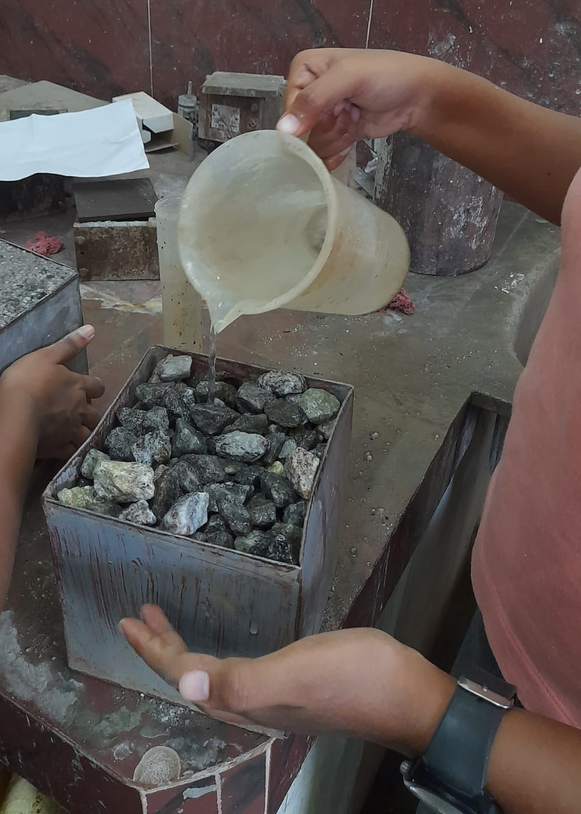
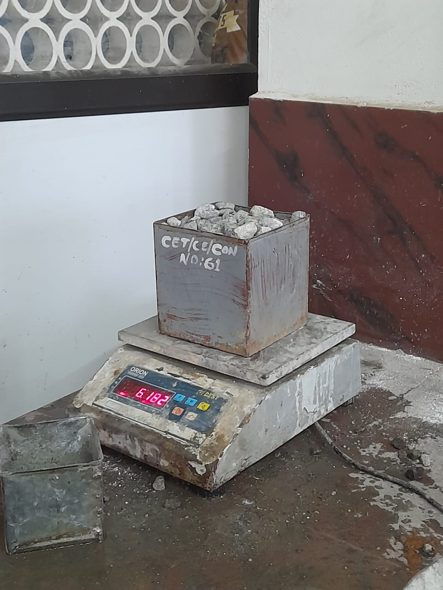
Fig.7 Testing Bulk density of coarse aggregate

Slide 15
SIEVE ANALYSIS OF COARSE AGGREGATE
1. Take about 3 kg of air-dried coarse aggregate and arrange sieves in the order: 80 mm, 40 mm, 20 mm, 10 mm, and 4.75 mm (largest on top).
2. Sieve the sample for at least 15 minutes using varied motions without forcing material through the sieves.
3. Weigh the amount of aggregate retained on each sieve to determine the particle size distribution.

Slide 16
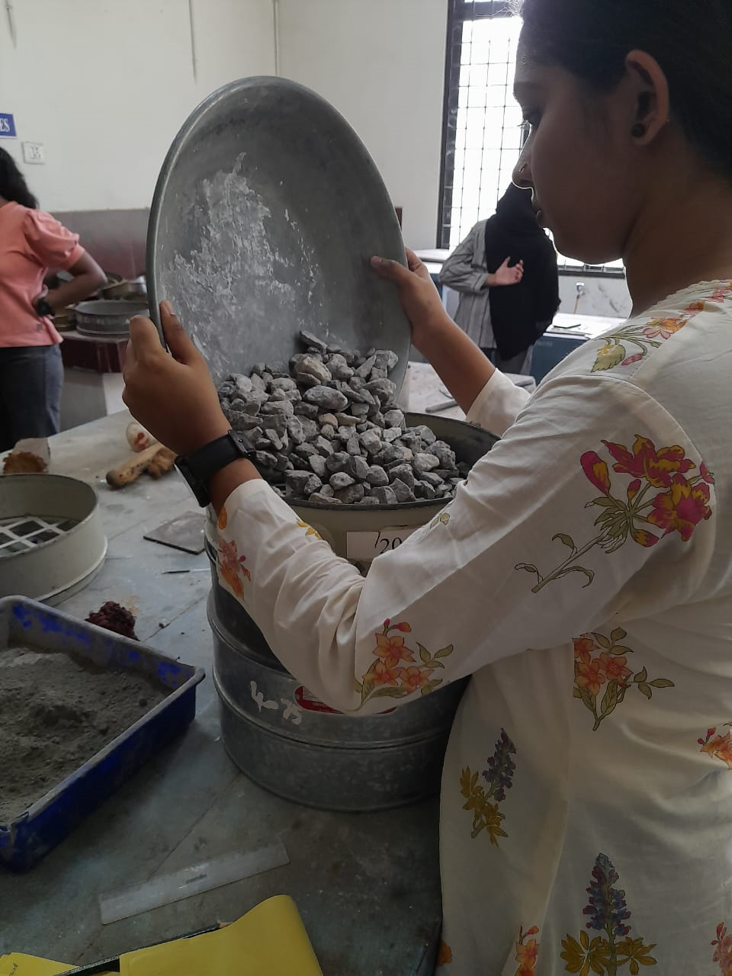
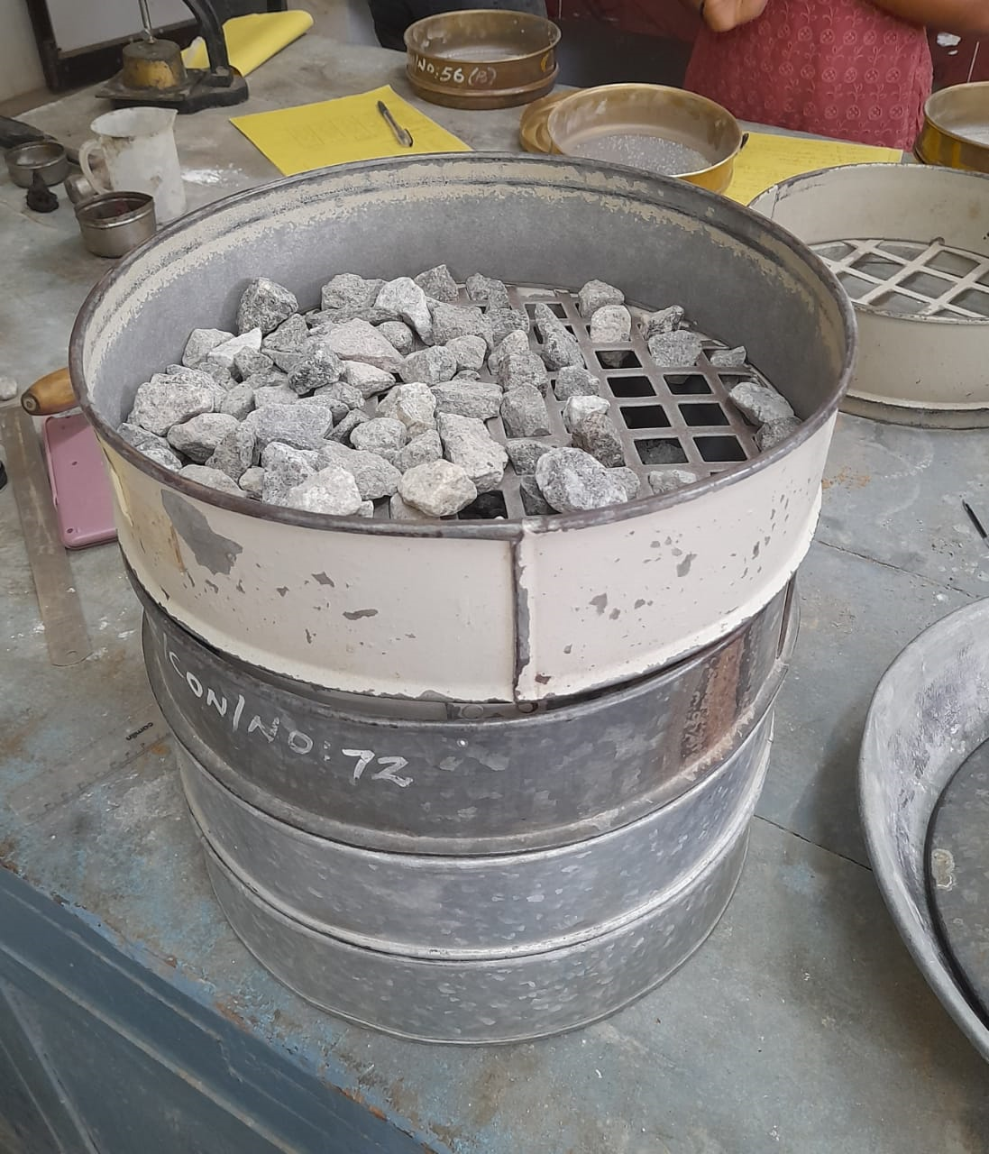
Fig. 8 Sieve analysis of coarse aggregate

Slide 17
5. Tests on Fresh Concrete: Slump, Compaction factor test
To prepare the concrete mix of proportion 1:x:y with water-cement ratio k, the measured dry ingredients (cement, fine, and coarse aggregates) are thoroughly mixed, water is added, and the mix is made homogeneous. The concrete is then placed in layers, each tamped properly, and tests like slump and compacting factor are performed to assess workability.

Slide 18
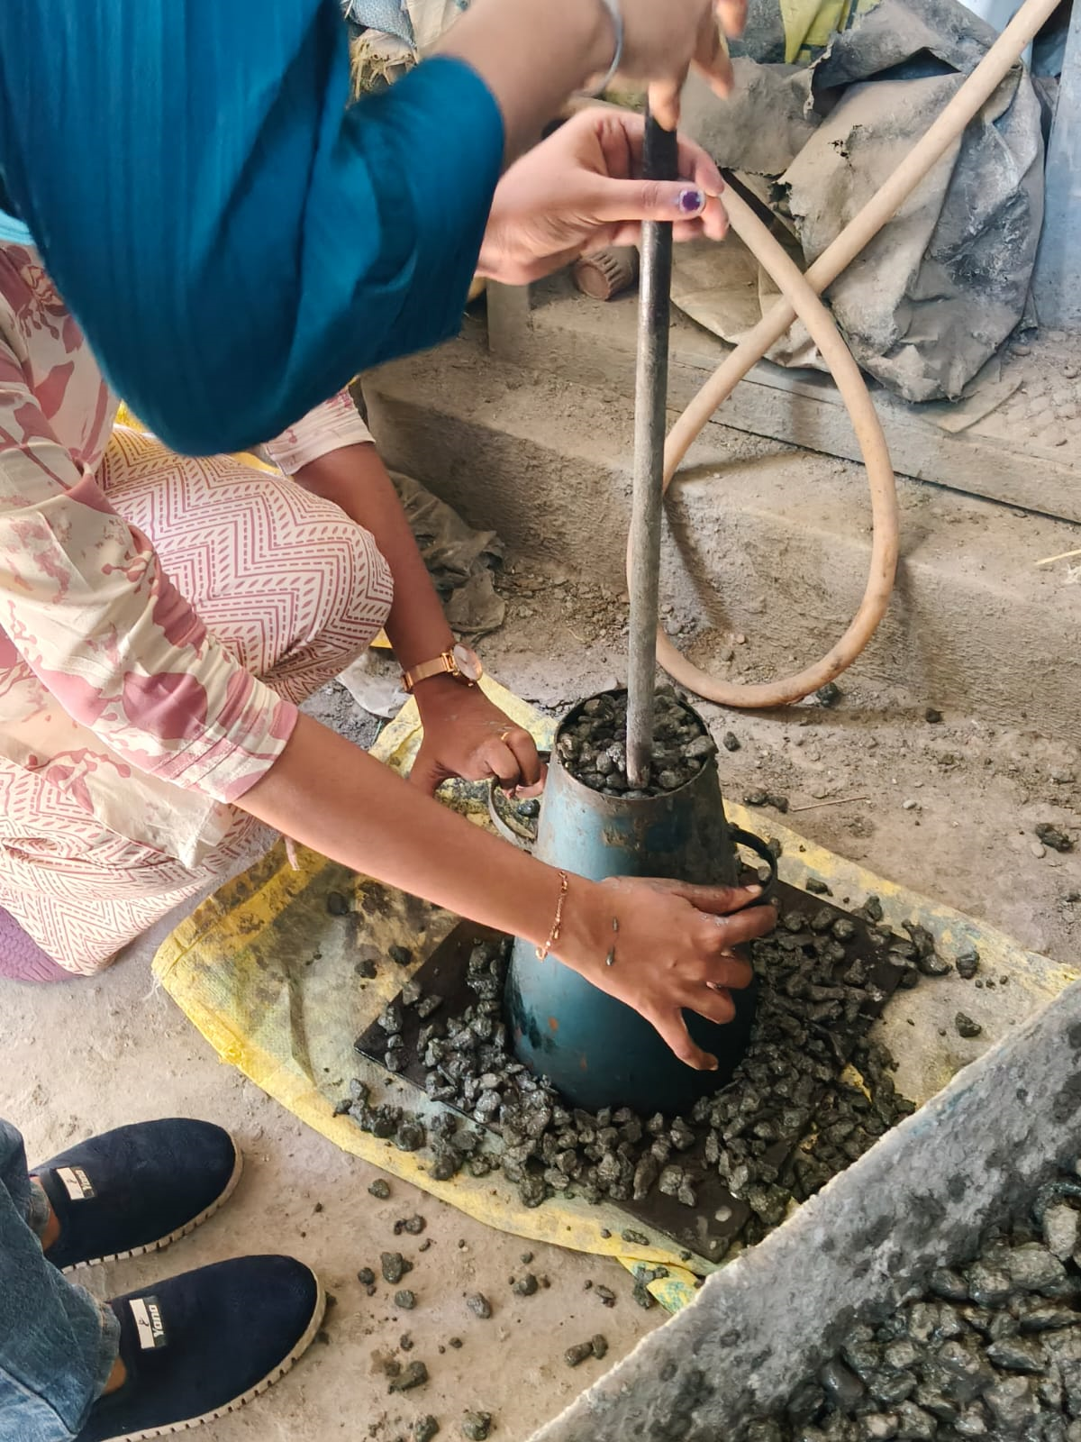
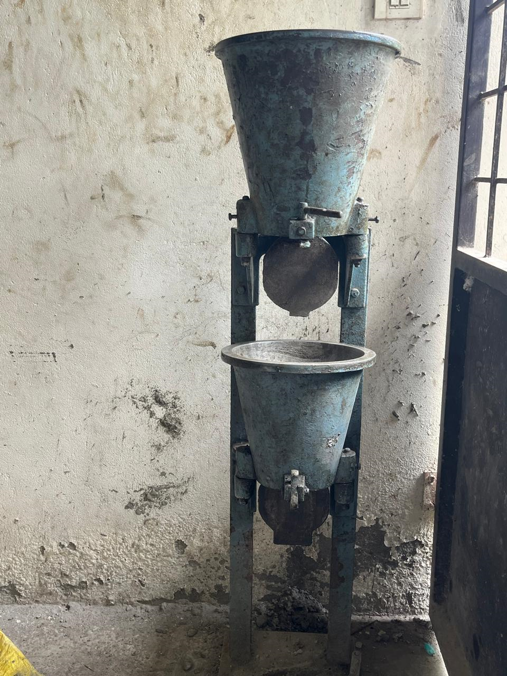
Fig.9 Slump Test Fig.10 Compaction factor test

Slide 19
6. Determination of Compressive Strength of Concrete
The concrete cube specimen is taken out of water, cleaned, and its dimensions are measured. It is placed centrally on the testing machine with the load applied perpendicular to the casting direction. Load is applied gradually at about 140 kg/cm²/min until failure, and the maximum load and type of failure are recorded.

Slide 20
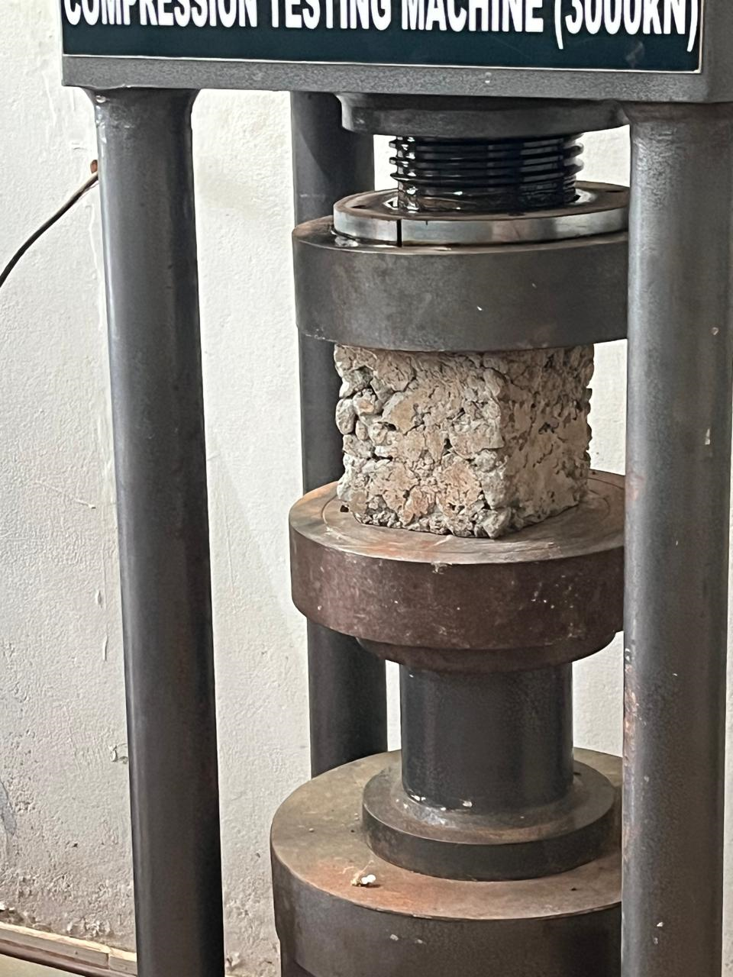
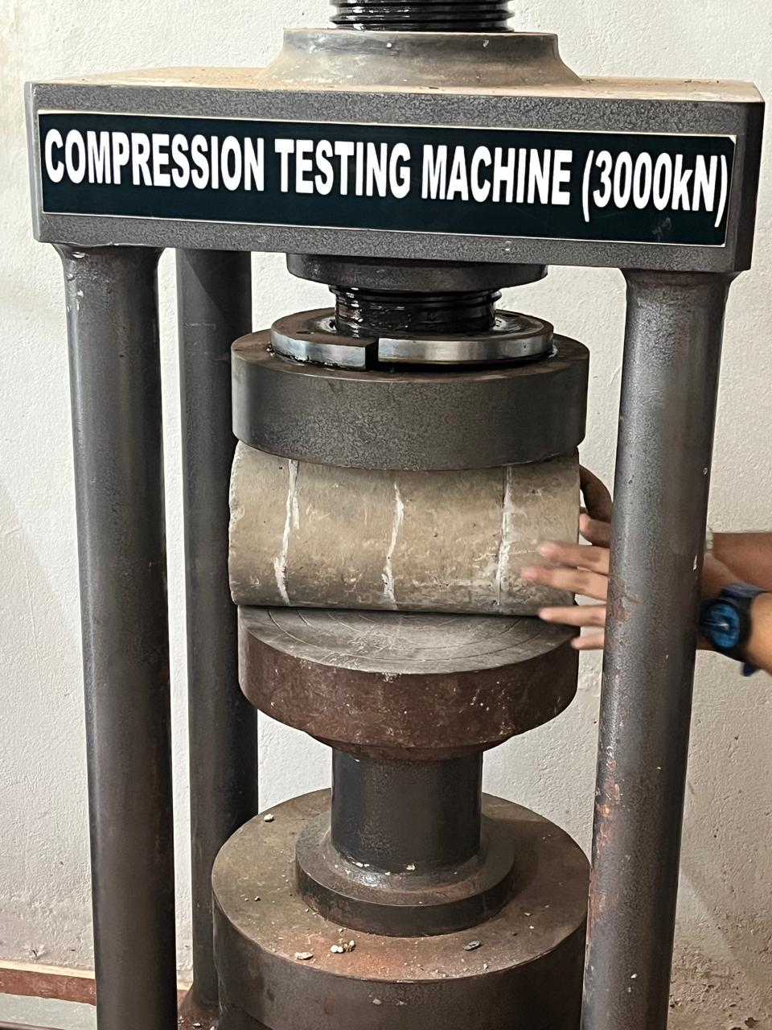
Fig. 11 Compression test set up Fig. 12 Split tensile strength test set up

Slide 21
7. Carrying out the Split Tensile and Flexural strength of Concrete.
The wet specimen is cleaned, measured, and marked with diametrical lines for alignment. It is placed between two plywood strips on the testing machine, ensuring proper positioning. Load is applied gradually at a rate of 1.2 to 2.4 N/mm²/min until failure, and the maximum load and type of failure are recorded.

Slide 22
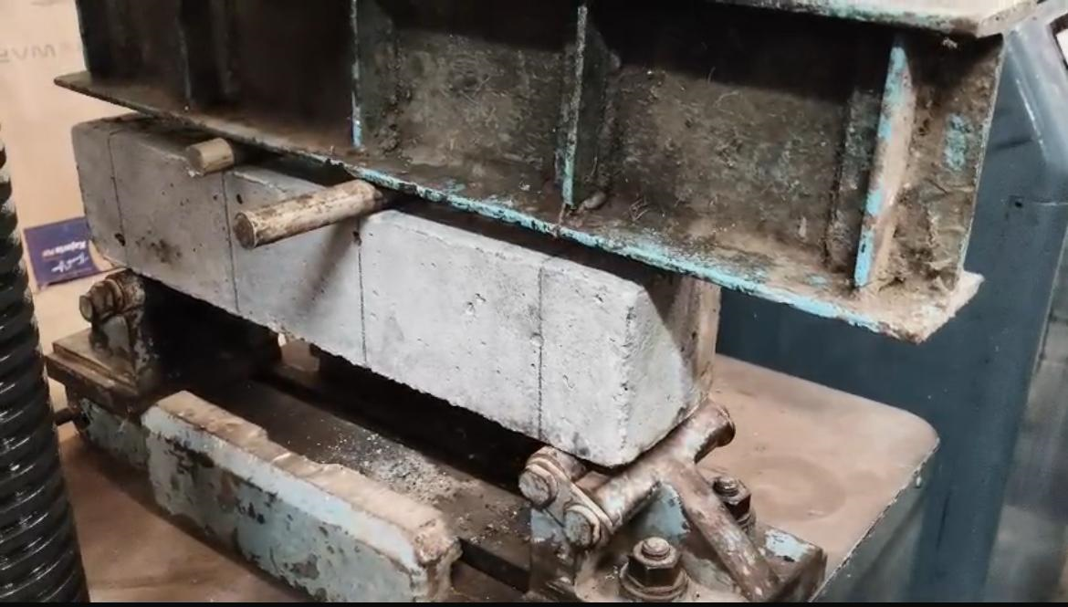
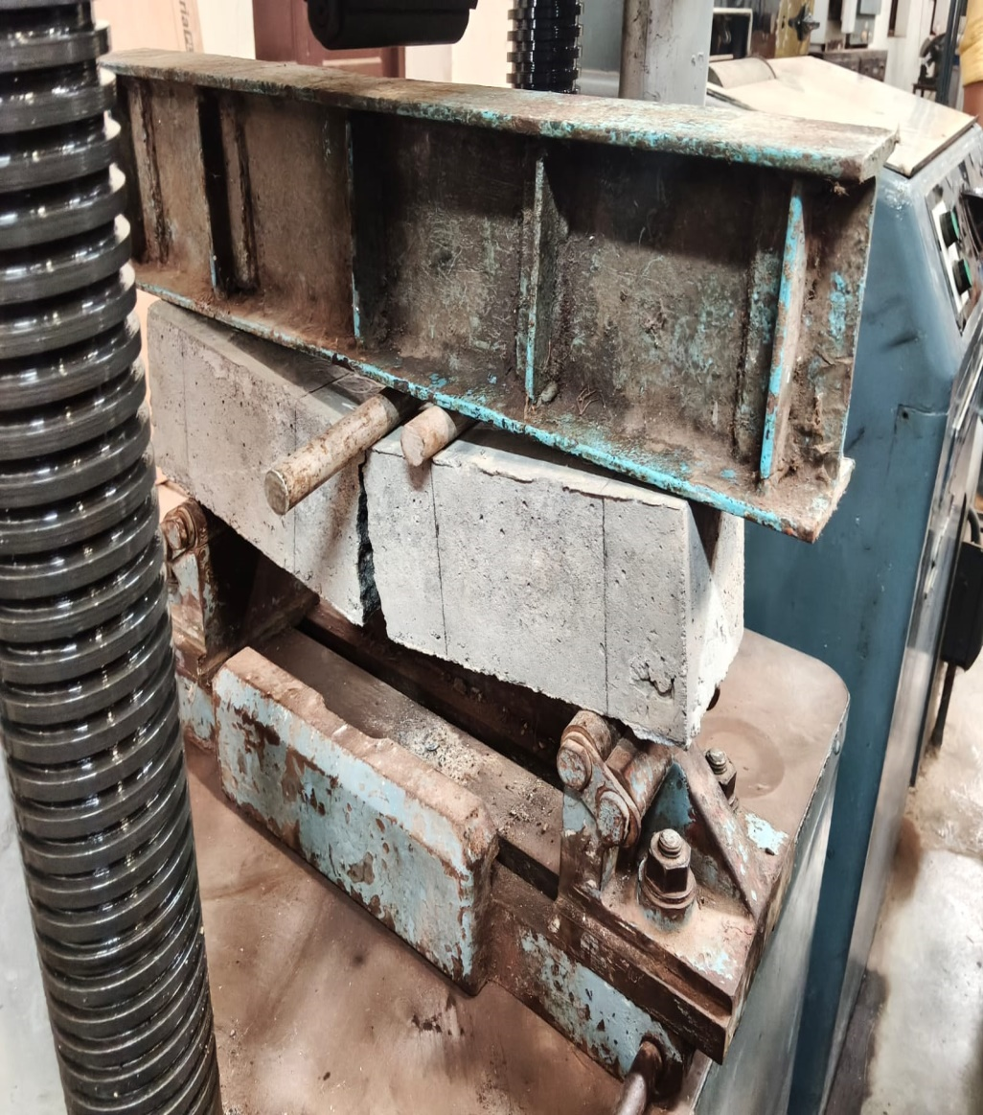
Fig.13 Flexural strength testing

Slide 23
8. Compressive strength of brick
Place the specimen with flat faces horizontal, and mortar filled face facing upwards between two 3-ply plywood sheets each of thickness 3mm and carefully centered between the plates of the testing machine. Apply load axially at a uniform rate of 14 N/mm2 (140 kgf/cm2) per minute till failure occurs and note the maximum load at failure. The load at failure shall be the maximum load at which the specimen fails to produce any further increase in the indicator reading of the testing machine.

Slide 24
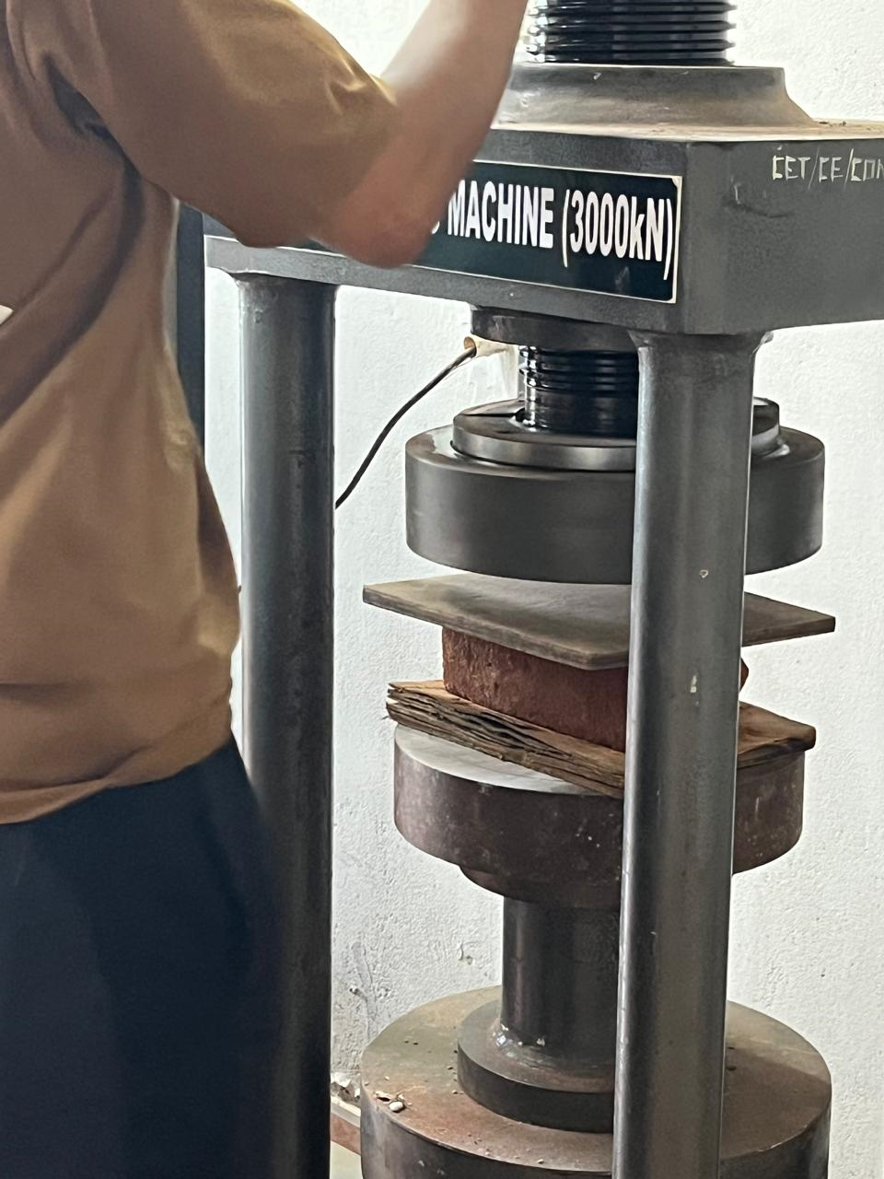
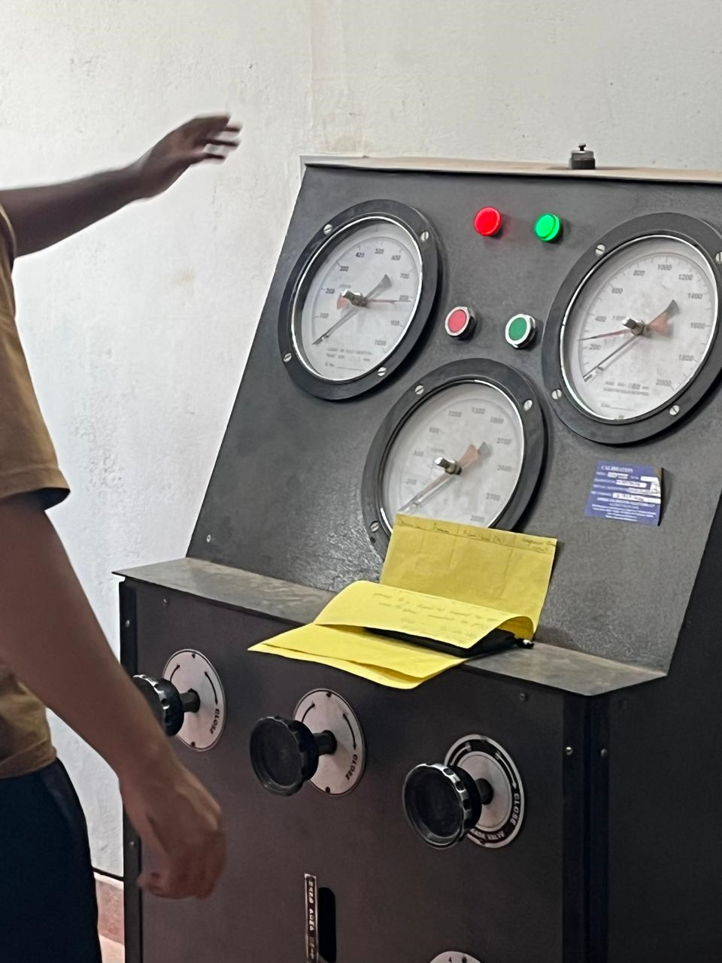
Fig. 14 Compressive strength test on brick

Slide 25
9. Transverse strength of tiles
The tile is placed on two parallel supports and loaded at the center using a steel rod with plywood padding between contact surfaces. The load is applied gradually until the tile breaks, and the breaking load P is recorded. The wet transverse strength is then calculated using the formula f = 3Pl/2bt^2, where l is the span, b the width, and t the thickness of the tile.

Slide 26
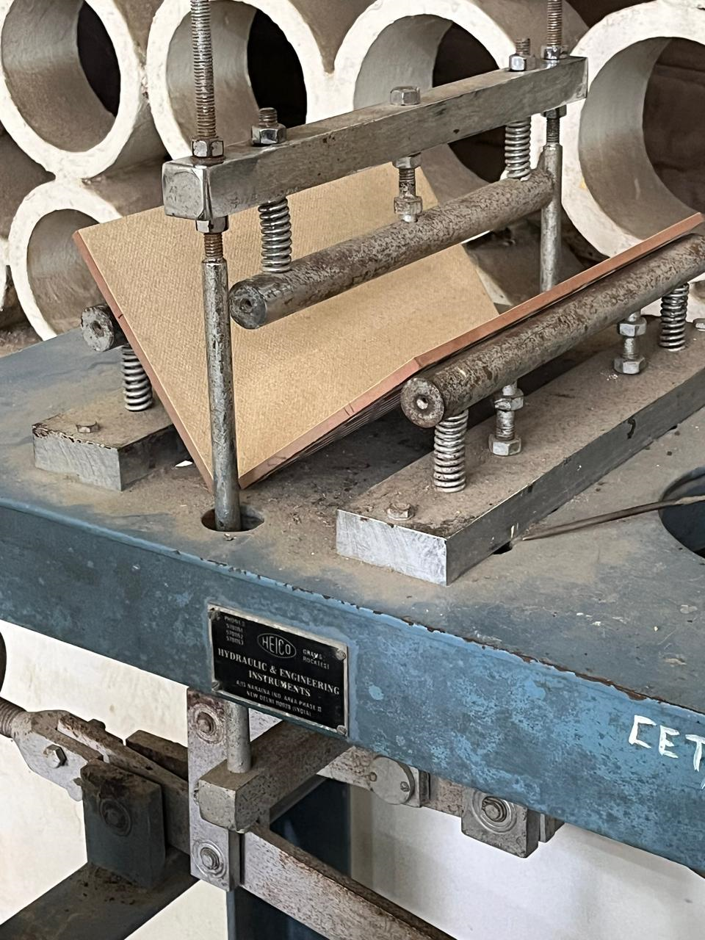
Fig.15 Transverse strength of tile

Slide 27
11. Non destructive tests (rebound hammer & ultrasonic pulse velocity)
1. Ultrasonic Pulse Velocity (UPV) Test : In this test, an ultrasonic pulse is passed through the concrete using transducers placed on opposite sides of the specimen. The time taken for the pulse to travel through the concrete is measured, and the pulse velocity is calculated. Higher velocity indicates good quality, dense concrete, while lower velocity indicates cracks or voids.

Slide 28
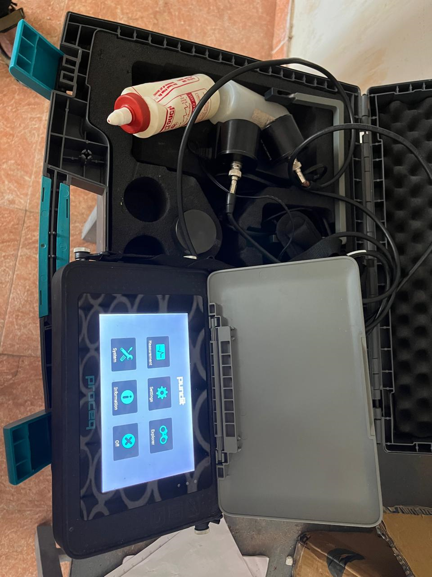
Fig .17 Ultrasonic pulse velocity equipment

Slide 29
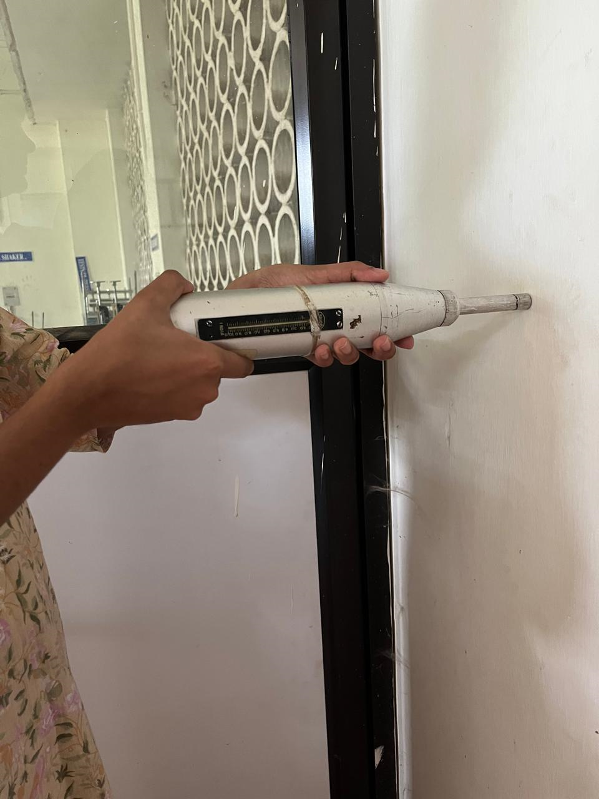
2. Rebound Hammer Test: The rebound hammer is pressed against the concrete surface, and the rebound value (rebound number) is noted from the scale. This number gives an indication of the surface hardness, which is correlated to the compressive strength of concrete using standard charts.
Fig. 18 Rebound hammer test

